Slide 1


Navigating a systematic review result section
Virtual course on systematic reviews and meta-analysis
African Institute for Development Policy/University of Malawi
Ola Adetokunboh
Stellenbosch University
Cape Town
August 2020

Slide 2
LEARNING OBJECTIVES
After completion of this lecture you should be able to understand:
Study selection
Study characteristics
Risk of Bias
Synthesis of results
Additional analyses

Slide 3
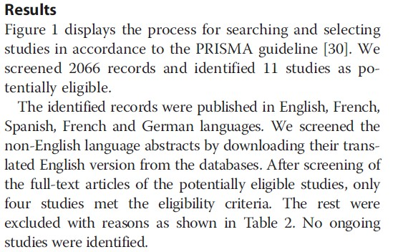
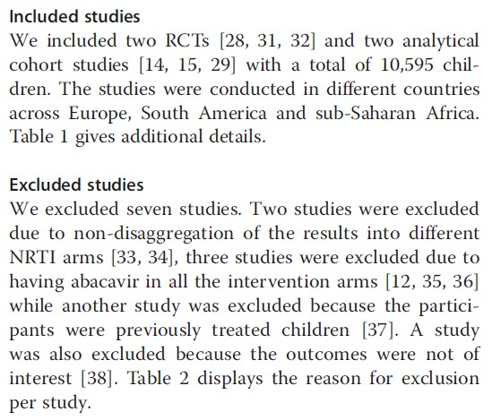
STUDY SELECTION
Numbers of studies screened
Studies assessed for eligibility
Studies included in the review
Excluded studies with reasons for exclusions
Ideally with a flow diagram

Slide 4
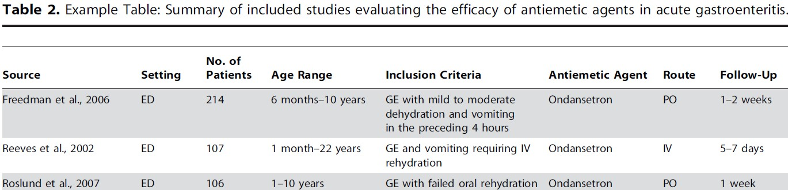
STUDY CHARACTERISTICS
Present study characteristics for which data were extracted:
Study size
PICOS
Follow-up period
Citation

Slide 5
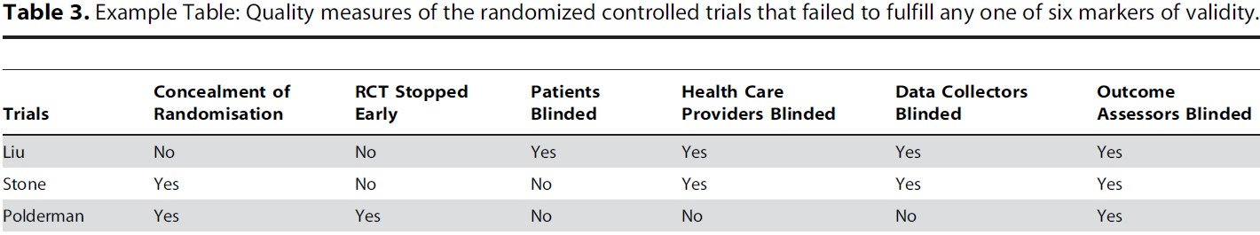
RISK OF BIAS WITHIN STUDIES
Data on risk of bias of each study

Slide 6
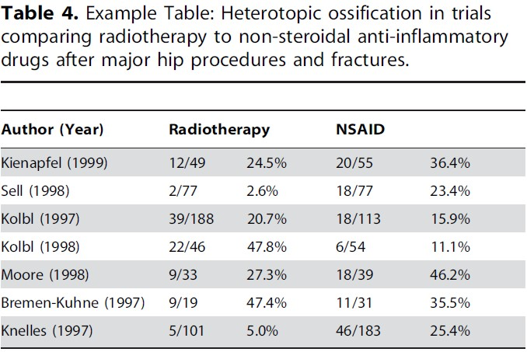
RESULTS OF INDIVIDUAL STUDIES
For all outcomes considered (benefits and harms), present, for each study:
Simple summary data for each intervention group

Slide 7
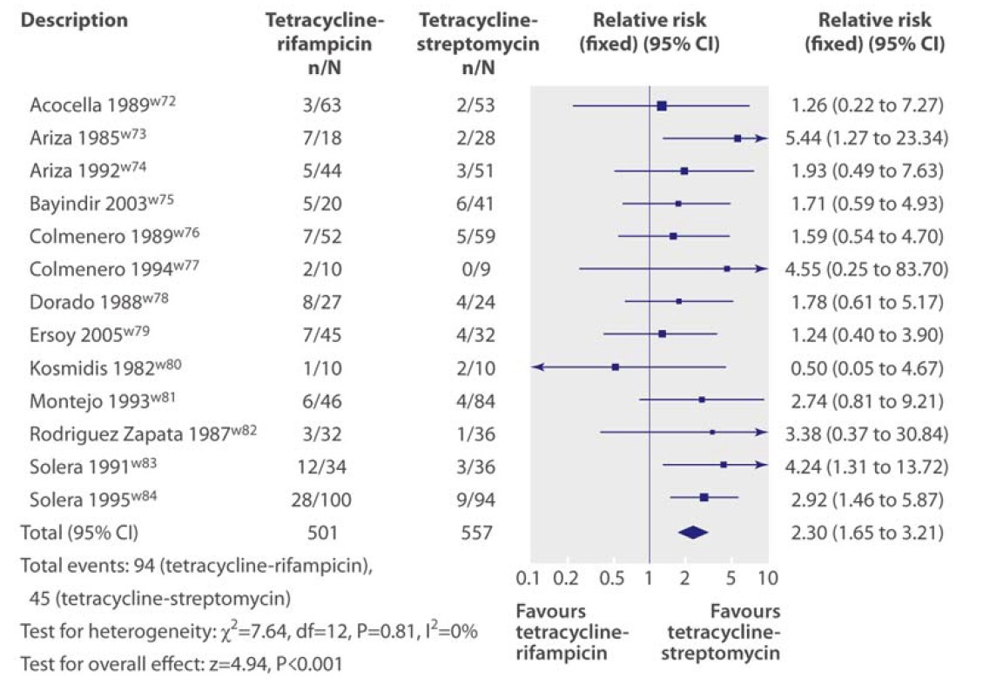
SYNTHESES OF RESULTS
Present the main results of the review.
For meta-analysis, include confidence intervals and measures of consistency.
Effect estimates and confidence intervals, ideally with a forest plot.

Slide 8
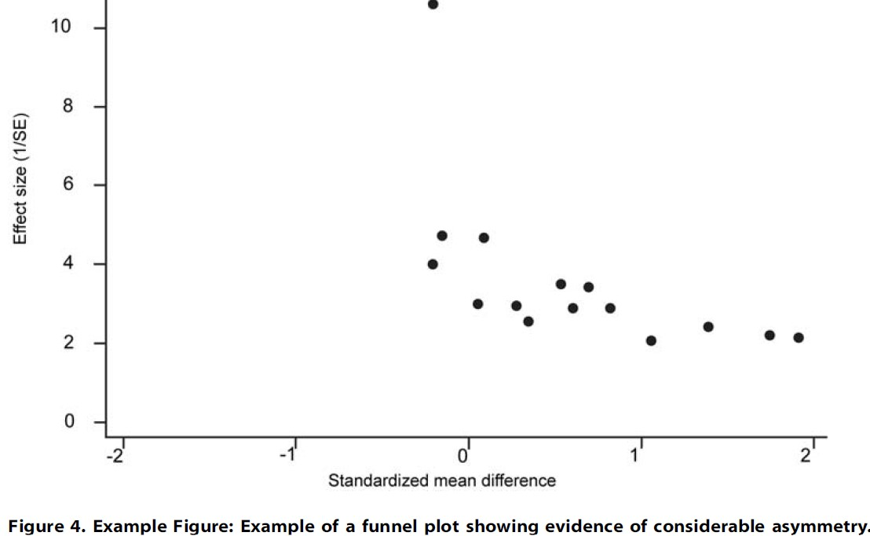
RISK OF BIAS ACROSS STUDIES
Present results of any assessment of risk of bias across studies
‘‘Strong evidence of heterogeneity (I2 =79%, P,0.001) was observed. To explore this heterogeneity, a funnel plot was drawn. The funnel plot in Figure 4 shows evidence of considerable asymmetry.’’

Slide 9
ADDITIONAL ANALYSES
Give results of additional analyses if done:
Sensitivity or subgroup analyses
Meta-regression

Slide 10
ACKNOWLEDGMENT
Alessandro Liberati
Jean Nachega

